Slide 1
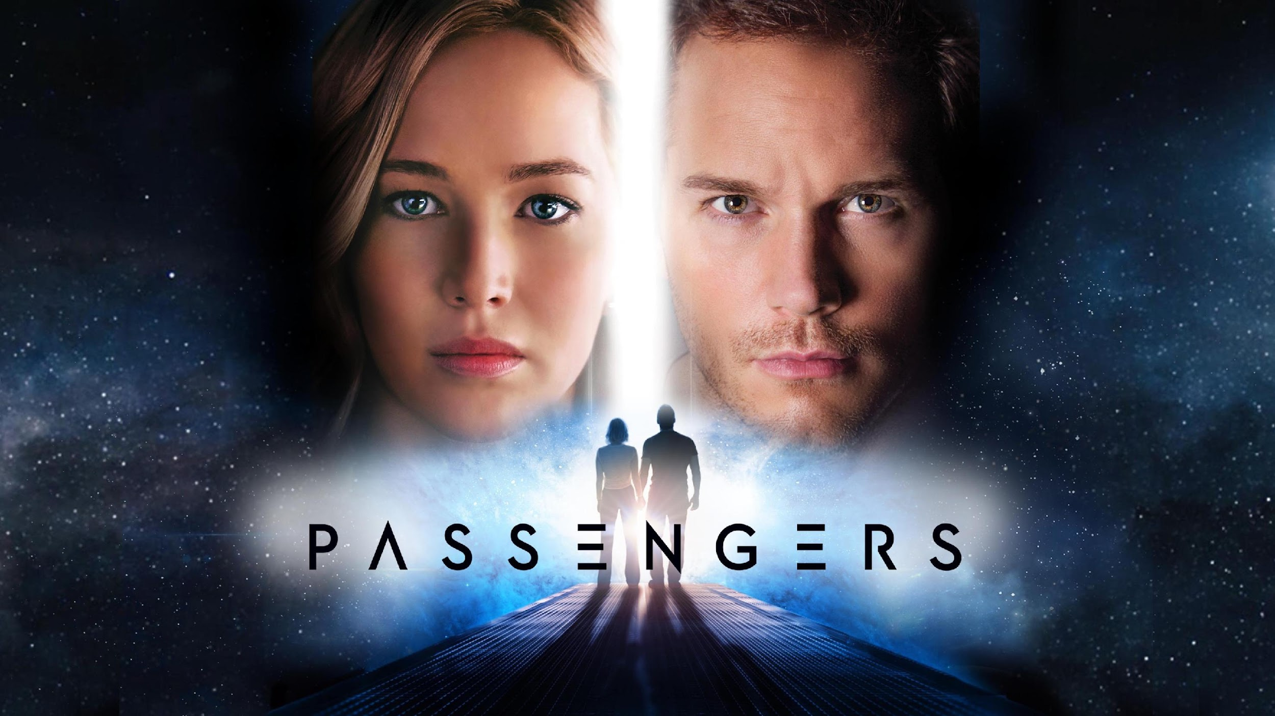
Passengers(2016) Conclusions
[17]
Alex Li, Zackary Perry, Vaansh Mansharamani, Simon Tong

Slide 2
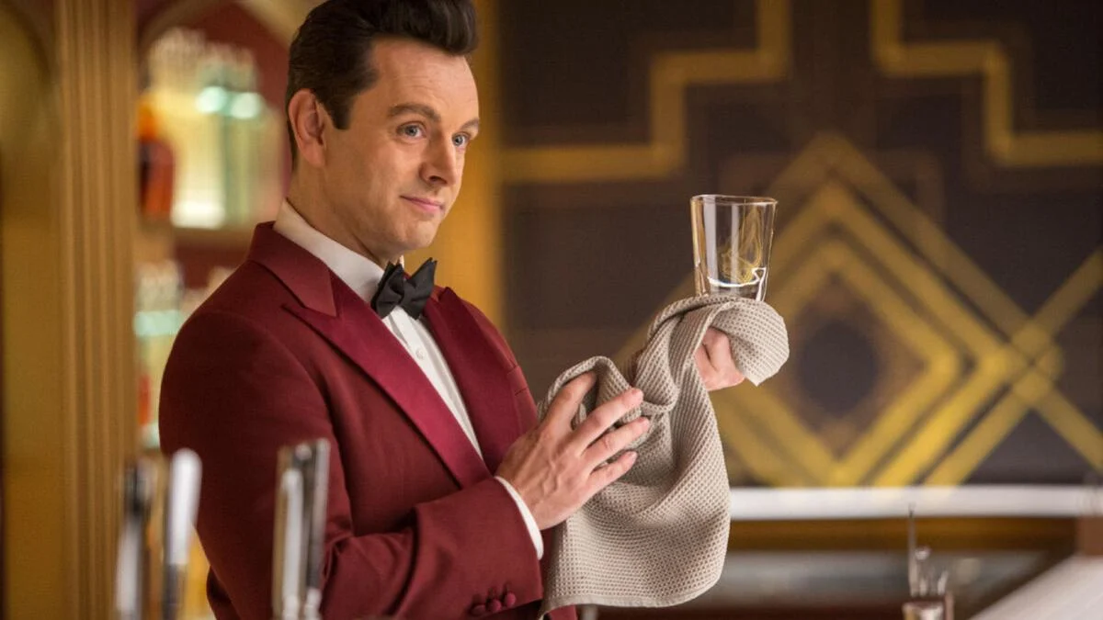
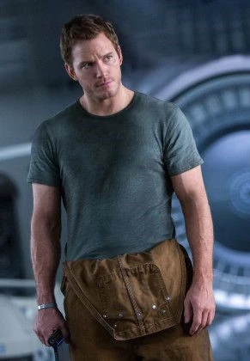
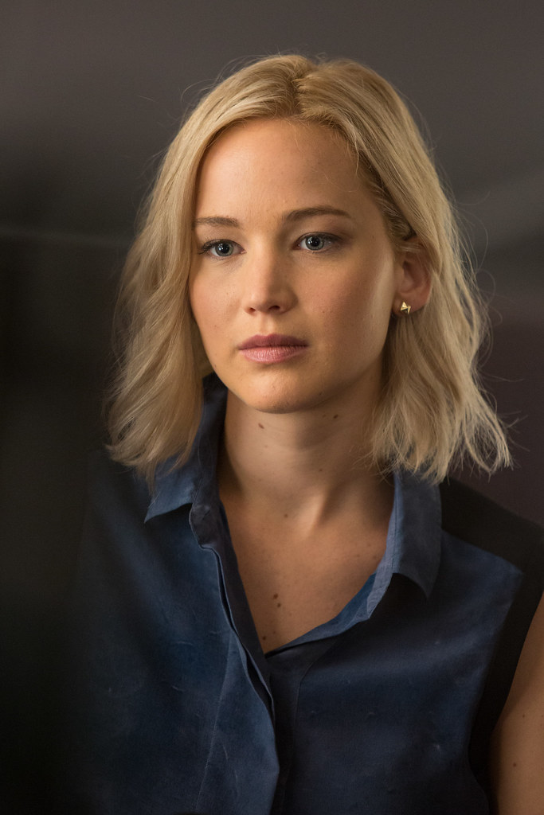
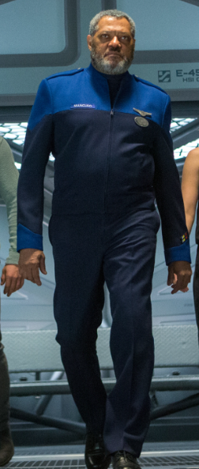
Characters
Arthur the robot bartender who tends the bar
[19]
[1]
[2]
[3]
Jim Preston(mechanic who wakes up first
Aurora Lane(reporter woken up by Jim
Gus Mancuso(plot device, also a deck crew manager)
Notes:
TO DO: Quickly introduce these Characters: Jim Preston, Aurora Lane, Gus Mancuso:
Jim: A Engineer back on earth, was travelling to Homestead 2 to work there as an engineer. And was the one that woke up Aurora. Was awoken by a hib pod malfunction
Aurora: A writer from new york city, travelling to Homestead 2 to spend a year and return to earth to report on the experience. Was awoken prematurely by Jim
Gus: Deck Chief of the Avalon, was awoken due to a hib pod malfunction

Slide 3
Timeline (Plot Summary) 2min DELETE WHEN SLIDE 4 DONE
Jim awoken early due to hib pod malfunction. Talks to robot bartender. Wakes up Aurora, Ship starts experiencing failures, Gus (Deck chief) wakes up due to hib pod malfunction, shows Jim and Aurora the situation using his ID privileges, Gus dies(from his hib pod causing sickness or from old age), Jim and Aurora enter the engine room, Jim&Aurora release ththe pressure of the chamber by Jim going outside to physically release, while Aurora does something else, Ship is saved, Jim Aurora die of old age, but the remaining hibernating passengers are saved, along with the ship.
Make more condensed. Less words, put images if possible

Slide 4
Plot Summary
Jim wakes up on the Starship Avalon 90 years too early
He tries to get access to help in any way he can but fails
After experiencing all the ship has to provide, Jim falls into depression
He meets Aurora who is still asleep, but falls in love with her and struggles with waking her up
After a year, he gives in, tampering with her hibernation pod
It takes some time, but the two of them are able to live together on the Avalon for another year

Slide 5
Computing Technologies REPLACE WITH PICTURES
The Fusion Reactor Autopilot system
Spacesuits
Hibernation Pods
Diagnostic System (Backup plan)
Autodoc anymore if can find more that are relevant to arguments

Slide 6
Conclusion 1
There needs to be sufficient redundancy measures in place on all computing systems to avoid detrimental scenarios.

Slide 7
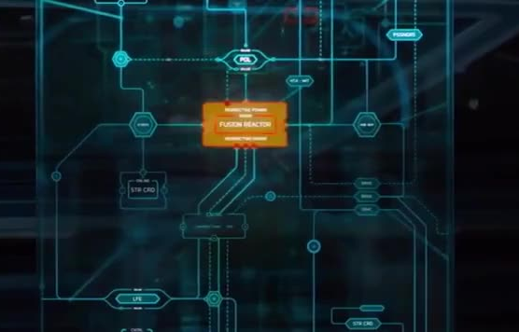
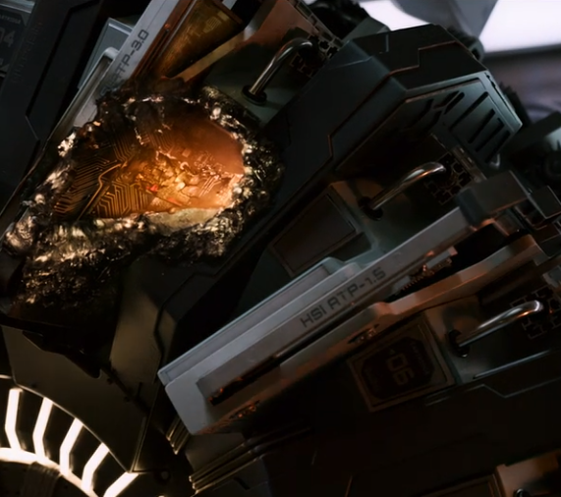
Reason 1:The Fusion Reactor Computer
[5]
Fusion Reactor Computer controls all power within the ship
Is destroyed by meteor, no sufficient backup plan to repair it
Problem was a hardware related issue, needed to be repaired by a human
[4]
Notes:
Write Notes here on what to say. For this one, explain the fusion reactor computer, what it does, and how it fails, and the effects of its failure.
In the movie, we see the Fusion Reactor Computer being the control of all power within the ship, and this computer fails, causing insufficient backup plans to take place, causing a cascade reaction going from bad to worse.

Slide 8
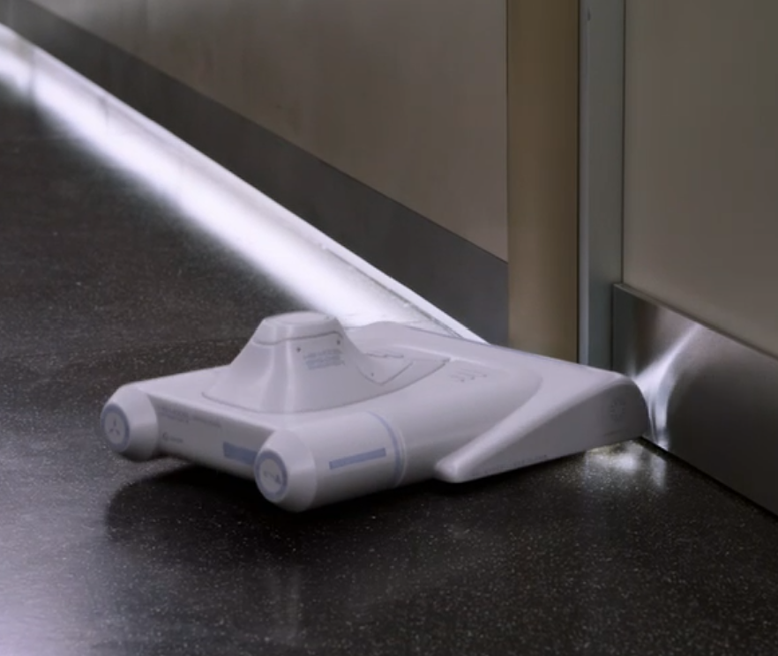
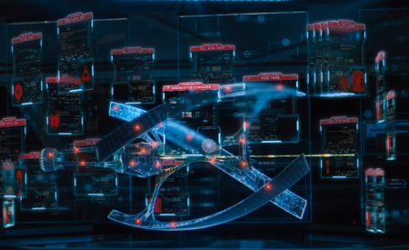
Reason 2: The Backup Plan
[21]
The backup plan for the ship was to distribute the job of the fusion reactor computer to control functions of the ship
“Everything on board’s thinking too hard,” resulting in burnt out processors
Put so much confidence in the ship, it didn’t even consider an alternative if something were to happen to it
[22]
Notes:
Reason of lack of redundancy being bad Put a good script, along with what the picture means when it is there.

Slide 9
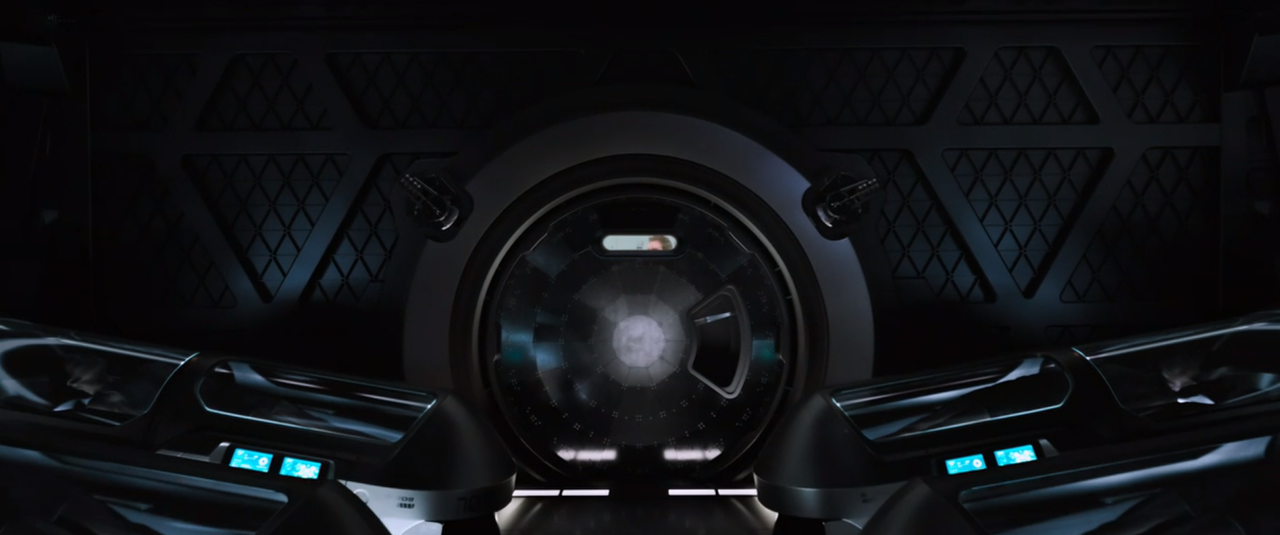
Reason 3: No systems to awake the crew members to look at failures within the ship
Crew is placed in hibernation pods with no way to wake them up, fully relying on Autopilot system to pilot the ship.
Ethically wrong. What if ship gets destroyed? Who is responsible?
[15]
Notes:
Another instance of lack of redundancy in the movie. Write speaker notes for this shit, and relate to ethics at the end i guess

Slide 10
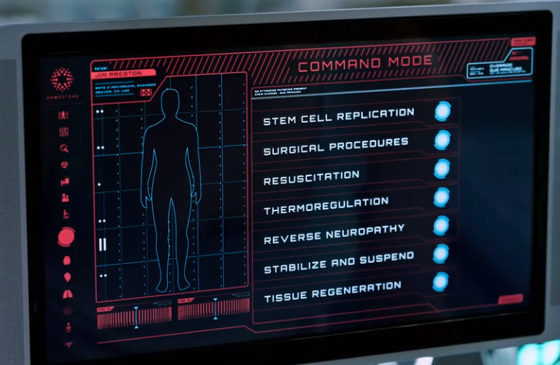
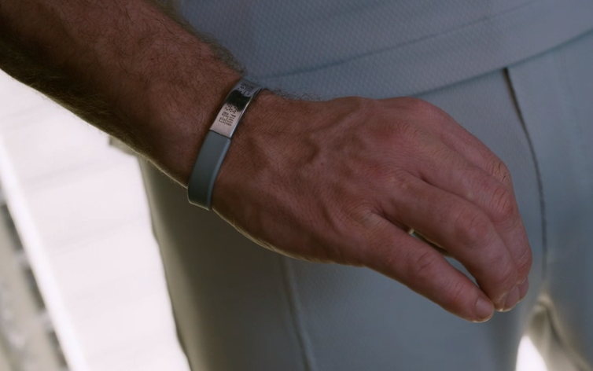
Reason 4: Autodoc & ID
[16]
Autodoc requires ID of a Crew Member to perform advanced commands
The ID of all Passengers controls all their privileges on the ship.
Ethically Inconsiderate, considering emergency
[17]
Notes:
Another example for the lack of redundancy. explain each of these technologies, and relate to the ethics
Advanced commands = “such as postmortem operations and the stopping of metabolic activity”
This is ethically inconsiderate as what if Gus never woke up, then no way of saving Jim’s Life…… Then who is responsible?
Also, for ID, what if it fail, what that passenger do, would that passenger be able access necessities like its room or food, probably not

Slide 11
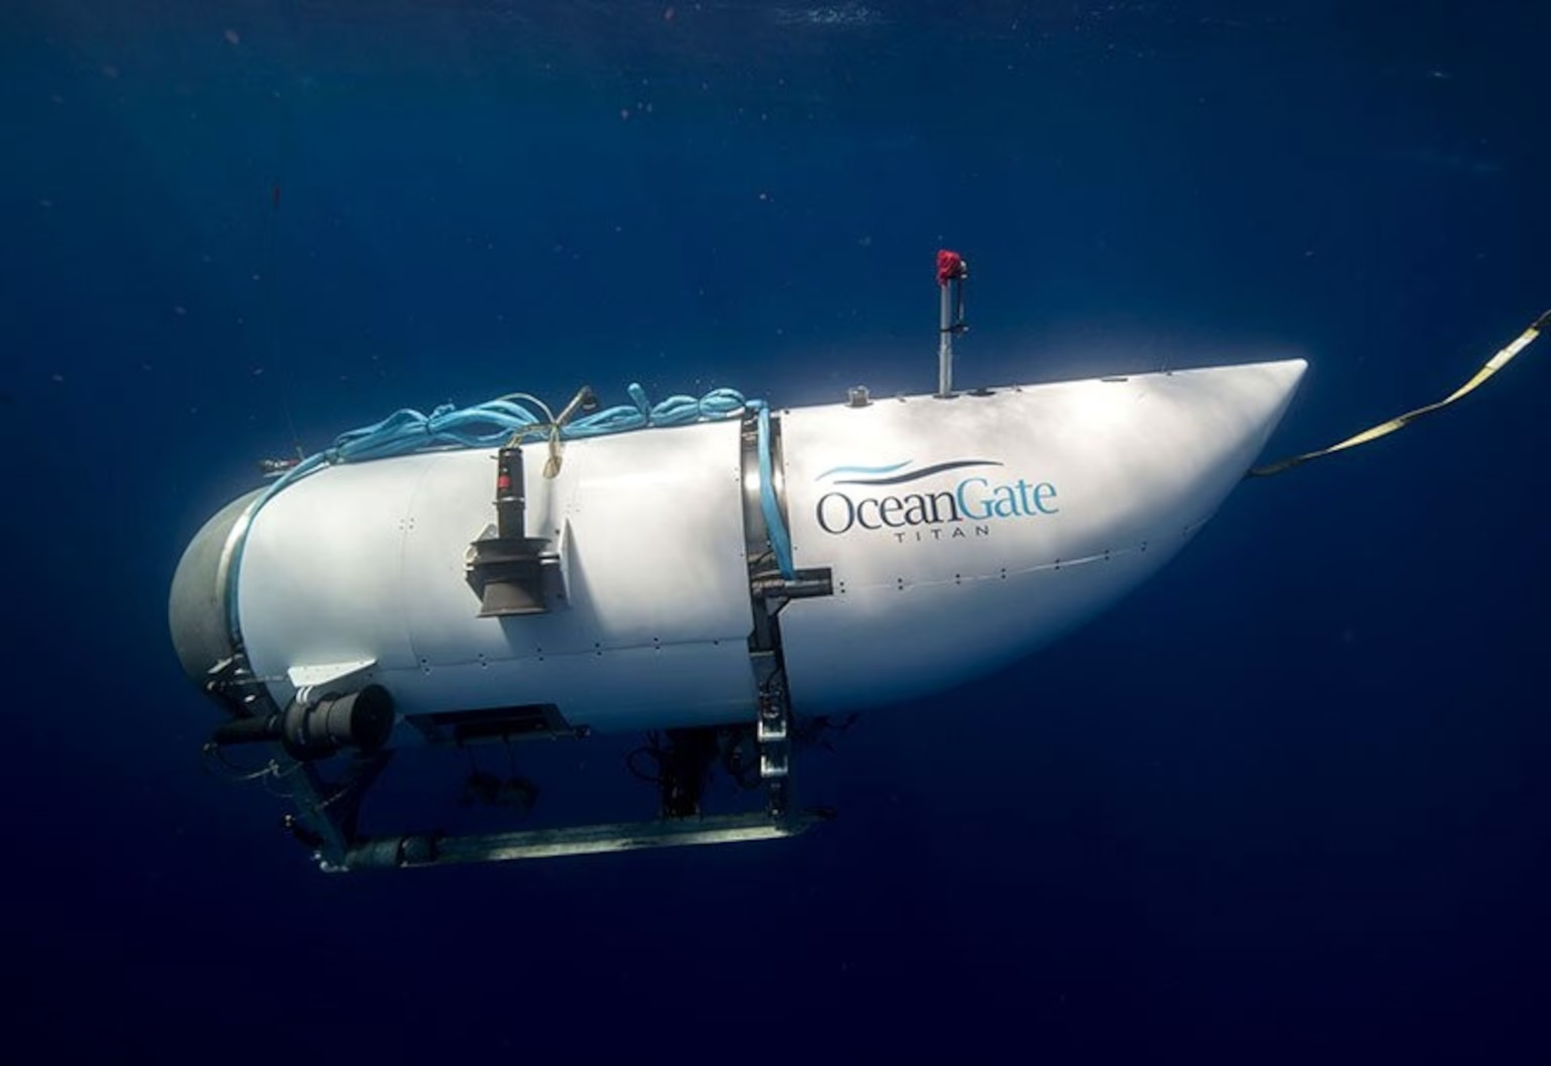
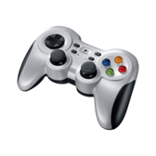
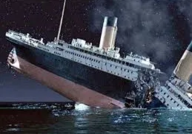
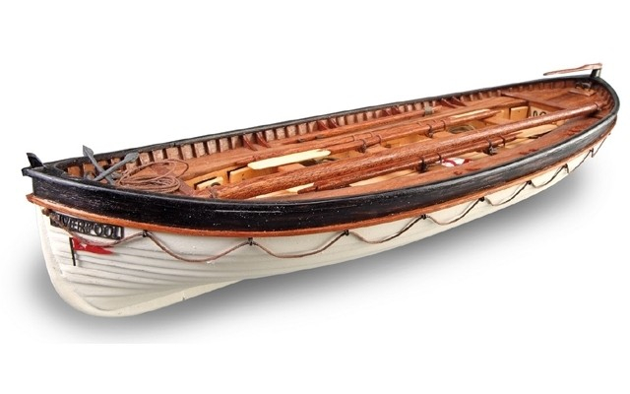
Reason 5: Real life Parallels of Lack of Redundancy
- Ocean Gate Titan Submarine
-The Titanic [1517 people died]
[6]
[8]
[7]
[18]
Notes:
REAL LIFE EXAMPLES. Introduce each of these. OCEANGATE: Use that logitech controller, but no backup when that controller failed cause sub implode
Titanic: Lack of Lifeboats cause these people to fucking die who care

Slide 12
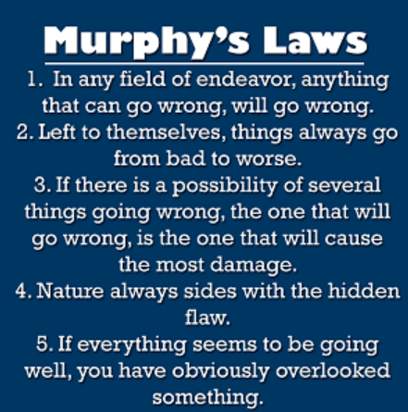
Murphy’s Laws
the ships reactor getting hit
Avalon overheating to try and fix the problem
asteroid hitting specifically the ships fusion reactor
nature=asteroid
“They never malfunction”-my boy arthur
[27]
Notes:
The image on the right describes some of Murphys most important laws. These laws were broken throughout the movie, and our thought that was interesting

Slide 13
Conclusion 2
Emphasizing the importance of honesty regarding safety information is crucial, due to the significant negative impacts that misinformation can have.
Notes:
CONCLUSOON 2; SAY THE THIG

Slide 14
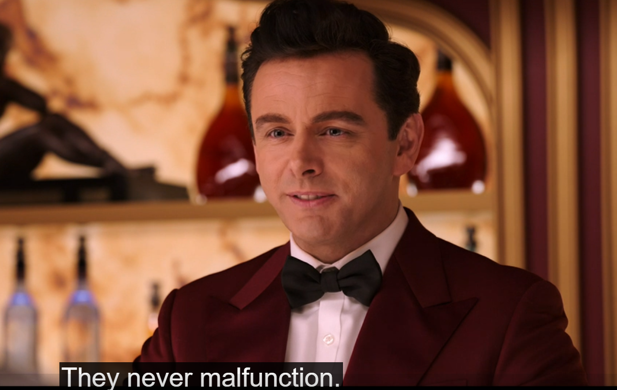
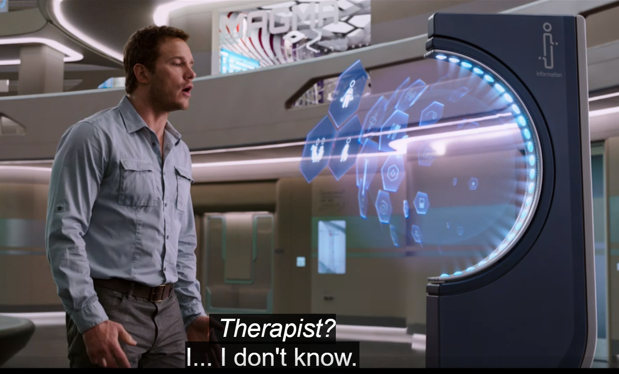
Reasons
Put image of the help desk here
[23]
[24]
Notes:
The false 100% safe advertising by the Homestead Company made it so that everyone believed it was safe, hence lack of redundancy measures(tie into previous conclusion), causing the condition on the ship.
The automated systems aboard the Avalon initially create an illusion of safety and convenience. However, this illusion is shattered when Jim discovers that critical information about the ship's condition has been concealed. This lack of transparency leads to a cascade of events that endanger not only Jim's life but also the lives of all passengers aboard. Therefore, the movie illustrates how honesty about safety information is essential to prevent potentially catastrophic outcomes and maintain trust in technological systems.

Slide 15
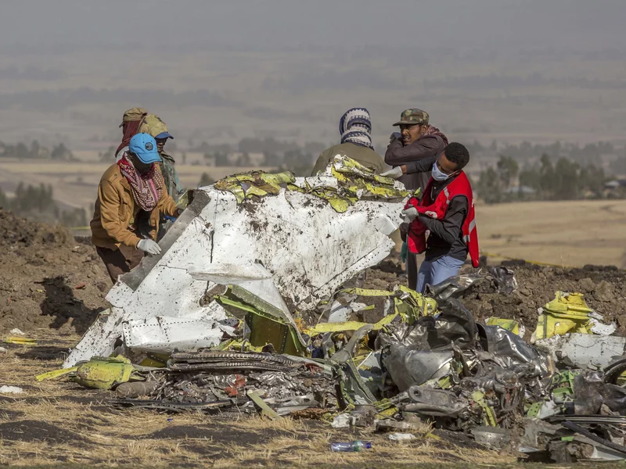
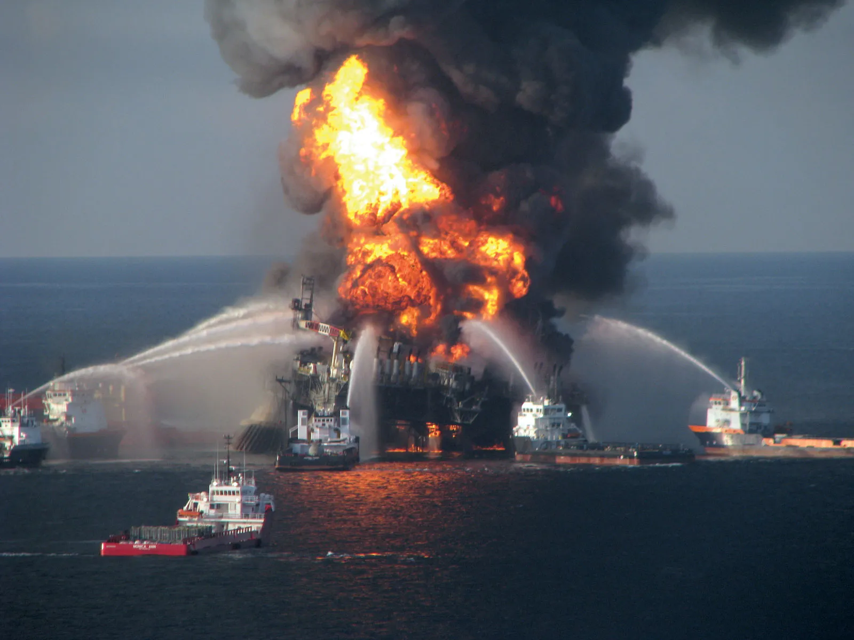
Real World Examples
The Boeing 737 MAX crash[11]
The Deepwater Horizon spill[13]
Notes:
REAL-LIFE EXAMPLES

Slide 16
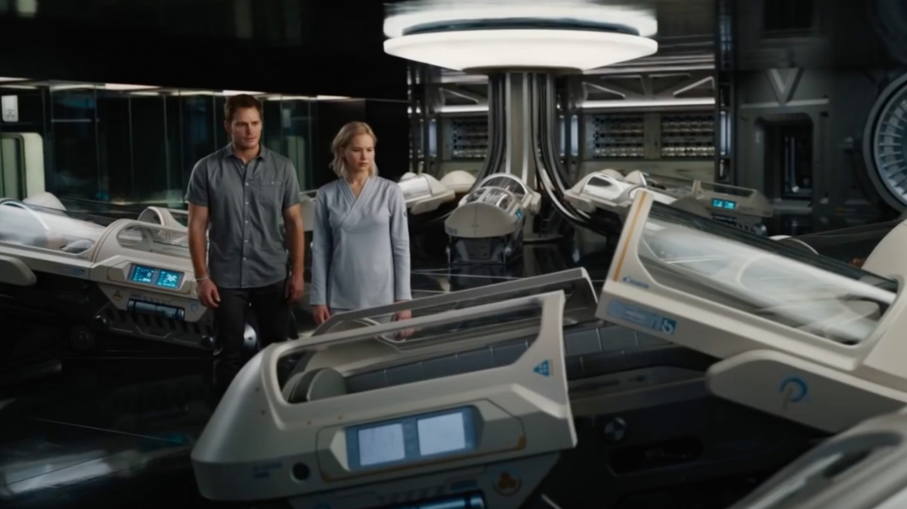
The Problem with - “100% Fail Safe”
“Absolute Certainty Is Not Scientific”
“There must be a way,”- Aurora when talking about going back to sleep in the pod
The Homestead Group advertised the Avalon is 100% safe, although it clearly isn’t
[9]
Notes:
Explain instance in the movie that is a argument for this conclusion. ‘THERE MUST BE A WAY” ALSO THE FALSE ADVERTISING OF HOMESTEAD saying the ship is failproof.

Slide 17
Conclusion 3
We should not be over reliant on Autopilot/AI systems for guidance of decision making.
Notes:
Script: And this is our third conclusion, which is ….. We should not be over reliant on Autopilot/AI systems for guidance of decision making.

Slide 18
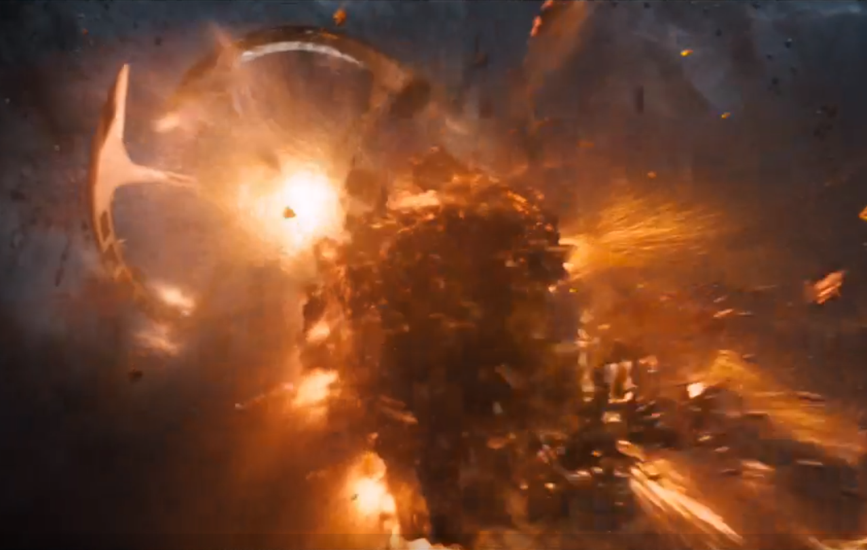
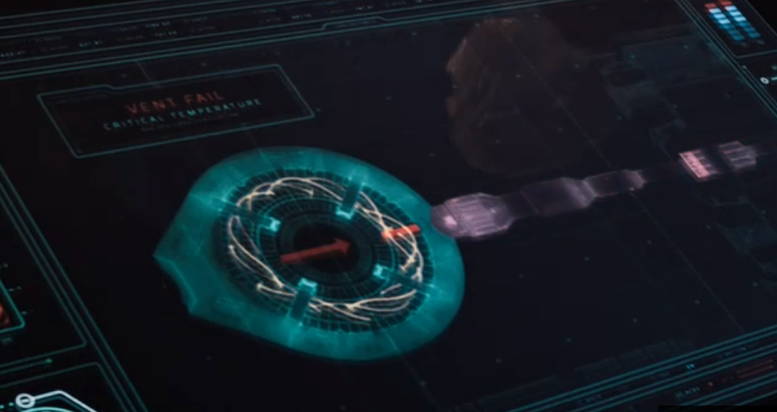
Reasons
Photo of asteroid hitting ship in beginning of movie
[25]
image of the system overheating to try to come up with the decision on what to do with the fusion reactor
[26]
Notes:
Say how the ship was saved by People: Jim and Aurora, technically Gus as well since he gave them is ID. AND WAS not saved by AI SYSTEMS.
As such, these AI systems cannot be trusted in key decision making
Also, we see Authur give overconfident answers despite them being wrong. Jim “but I am here”, Robot”But it is not possible for you to be here” .
In fact(RElate to real-life example of AI bias from debate)

Slide 19
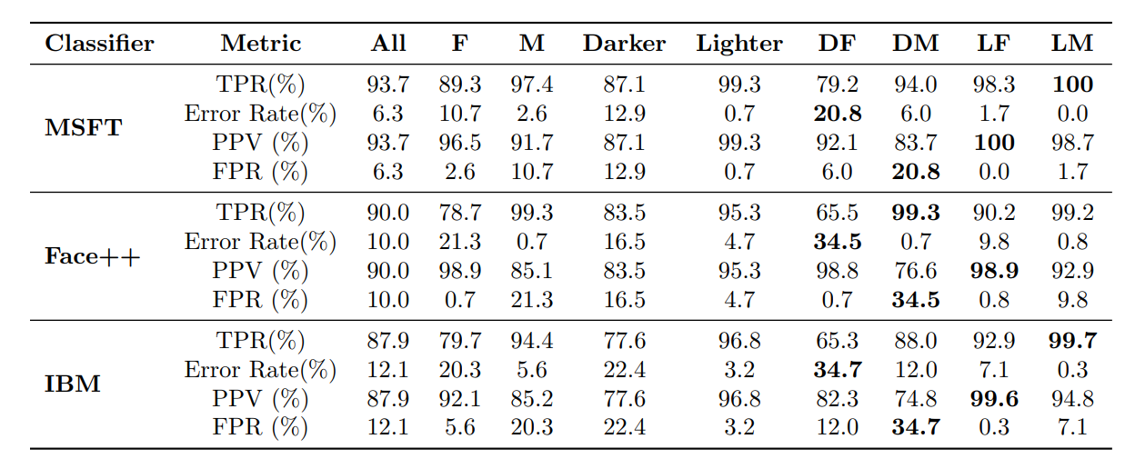
Increase Risk of Reliance on AI for Critical Decision Making
The autopilot system is the sole ‘pilot’ of the spaceship Avalon
In the movie, the spaceship was saved by People(Jim, Aurora), and not by the AI system. As such, people, or a higher level of tech is needed to make such critical decisions.
AI systems can exhibit biases and affect certain groups disproportionately, for example races [1]. Without human intervention, there can be unintended consequences.
[10]
Notes:
https://proceedings.mlr.press/v81/buolamwini18a/buolamwini18a.pdf

Slide 20
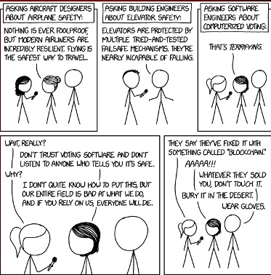
[20]
Notes:
This cartoon is a perfect example of all of what we talked about. In this image all the engineers talked about it being nearly incapable or noting ever being foolproof, which is something the Avalon did not do. They also put too much faith in a software system(the ships navigation) which let an Asteroid hit the fusion reactor on the ship. This cartoon explicitly makes it clear that good software engineers do not trust their own software

Slide 21
References
1.https://i.pinimg.com/originals/91/28/63/91286398d55f8605e76e18bb9c30b0bd.jpg
2.https://live.staticflickr.com/371/31913260434_66b48b71ff_b.jpg
3.https://i.imgur.com/lmKAZzq.jpg
4. Passengers (1:28:52)
5.MOVIE SOURCE
6. https://www.google.com/url?sa=i&url=https%3A%2F%2Fabcnews.go.com%2FUS%2Frun-risk-documents-detail-oceangates-battle-whistleblower-years%2Fstory%3Fid%3D106965104&psig=AOvVaw3IYChEFtIDc95X3rJpCQ20&ust=1713817399037000&source=images&cd=vfe&opi=89978449&ved=0CBIQjRxqFwoTCOirg7yR1IUDFQAAAAAdAAAAABAZ
7.https://i0.wp.com/timmaltin.com/wp-content/uploads/2019/05/broke-in-half.jpeg?fit=259%2C182&ssl=1
8.https://m.media-amazon.com/images/I/51iefaxmqeL.jpg
9.MOVIE SOURCE
10.https://proceedings.mlr.press/v81/buolamwini18a/buolamwini18a.pdf
11.https://www.npr.org/2021/01/08/954782512/boeing-to-pay-2-5-billion-settlement-over-deadly-737-max-crashes
12.https://www.ncbi.nlm.nih.gov/pmc/articles/PMC7351545/
13. https://www.britannica.com/event/Deepwater-Horizon-oil-spill
14.https://www.asme.org/topics-resources/content/the-ethical-lessons-of-deepwater

Slide 22
References Cont
15.Passengers(16:59)
16. Passengers(1:40:11)
17.https://resizing.flixster.com/-XZAfHZM39UwaGJIFWKAE8fS0ak=/v3/t/assets/p12939834_p_v12_at.jpg (4/23/2024)
18.https://www.stephensandkenau.com/wp-content/themes/modeShipYardTheme/timthumb.php?w=640&zc=1&q=100&src=https://www.stephensandkenau.com/wp-content/uploads/2015/10/19016-Titanic-Lifeboat.jpg&a=b (4/24/2024)
19. https://www.google.com/url?sa=i&url=https%3A%2F%2Fwww.thestar.com%2Fentertainment%2Fmovies%2Fpassengers-actor-michael-sheen-talks-about-being-a-robo-bartender%2Farticle_eaae723e-01a6-5e66-95a1-92f09866d2c0.html&psig=AOvVaw2mSUNvx6x9sdfII2duOAUi&ust=1714053306511000&source=images&cd=vfe&opi=89978449&ved=0CBIQjRxqFwoTCODK4KWA24UDFQAAAAAdAAAAABAE
20.https://xkcd.com/2030/
21.Passengers(40:32)
22.Passengers(1:13:31)
23.Passengers(14:07)
24.Passengers(9:26)
25.Passengers(3:05)
26.Passengers(1:29:43)
27. https://www.eit.edu.au/the-truth-behind-murphys-law/

